Slide 1

Research Methodology and Scientific Writing Chem 3072

Slide 2
Contents
Objectives of Research
Significance of Research.
What is Research?
Types of Research.
The Scientific Method.
Characteristics of a good research

Slide 3
Objectives of Research
The purpose of research is to discover answers to questions through the application of scientific procedures.
The main aim of research is to find out the truth which is hidden and which has not been discovered as yet.
Though each research study has its own specific purpose, we may think of research objectives as falling into a number of following broad groupings:

Slide 4
Objectives…
To gain familiarity with a phenomenon or to achieve new insights into it (studies with this object in view are termed as exploratory or formulative research studies);
To portray accurately the characteristics of a particular individual, situation or a group (studies with this object in view are known as descriptive research studies);
To determine the frequency with which something occurs or with which it is associated with something else (studies with this object in view are known as diagnostic research studies);
To test a hypothesis of a causal relationship between variables (such studies are known as hypothesis-testing research studies).

Slide 5
Significance of Research
All progress is born of inquiry. Doubt is often better than overconfidence, for it leads to inquiry, and inquiry leads to invention. Increased amounts of research make progress possible.
Research inculcates scientific and inductive thinking and it promotes the development of logical habits of thinking and organization.
Thus, research is the fountain of knowledge for the sake of knowledge and an important source of providing guidelines for solving different business, governmental and social problems.
It is a sort of formal training which enables one to understand the new developments in one’s field in a better way.

Slide 6
What is Research?
There are several definitions given for research by different writers. Some of these definitions are the following:
Research refers the application of the scientific method in the study of problems. It is a systematic attempt to obtain answers to questions about events through the application of scientific procedures.
Research is a scientific and systematic search for pertinent information on a specific topic.
Research is a systematic inquiry aimed at providing information to solve problems.
Research is a systematic process of collecting and analyzing information for some purpose.

Slide 7
What is Research?
One can easily pick the terms scientific and systematic from the above definitions.
Research is scientific because it is just a search for knowledge through recognized methods of data collection, analysis, and interpretation.
It is systematic because it uses some steps or procedures in doing this.
Generally, the purpose of research is to discover answers to questions through the application of scientific procedures.

Slide 8
Types of Research
Research can be classified in different ways: basic and applied; qualitative and quantitative; conceptual and empirical; etc. however, the following four main types of research are discussed briefly as follows:
Basic and Applied Research
Basic Research (also called pure or fundamental research):
“Gathering knowledge for knowledge’s sake is termed ‘pure’ or ‘basic’ research.”
It has a more general orientation, adding to the existing body of knowledge in the discipline.

Slide 9
Basic Research
It does not necessarily provide results of immediate, practical use, although such possibility is not ruled out.
It may consist of a research to develop and/or improve on theories, techniques and measurements.
It is aimed to solve perplexing questions of theoretical nature that have little direct impact on action, performance, or policy decisions.
Research concerning some natural phenomenon or relating to pure mathematics are examples of
fundamental research.

Slide 10
Types cont..
Applied Research (also called action research):
The purpose of applied research is to solve an immediate, practical problem.
It is oriented to a specific problem. It has a practical problem solving emphasis.
It emerges out of a general problem which faces a society as whole.
Marketing research or evaluation research are examples of applied research.
Generally, basic and applied researches are differentiated not by their complexity or value, but by their goals or purposes. The primary purpose of basic research is the extension of knowledge; the purpose of applied research is the solution of an immediate practical problem.

Slide 11
Types cont..
Quantitative and Qualitative Research
Quantitative Research: Research based on the measurement of quantity or amount.
Qualitative Research: Research concerned with qualitative phenomenon, i.e., phenomena relating to or involving quality or kind.
This type of research aims at discovering the underlying motives and desires, using in depth interviews for the purpose.
Attitude or opinion research i.e., research designed to find out how people feel or what they think about a particular subject or institution is also qualitative research.
Qualitative research is specially important in the behavioral sciences where the aim is to discover the underlying motives of human behavior.

Slide 12
Types cont..
Conceptual Vs Empirical Research
Conceptual Research: related to abstract ideas or theories. Commonly used by philosophers and thinkers to develop new concepts or to reinterpret existing ones.
Empirical Research: relies on experience or observation alone. It is data based research coming up with conclusions which are capable of being verified by observation or experiment.
Notes:
We can also call it as experimental type of research. In such a research it is necessary to get at facts firsthand, at their source, and actively to go about doing certain things to stimulate the production of desired information. In such a research, the researcher must first provide himself with a working hypothesis or guess as to the probable results. He then works to get enough facts (data) to prove or disprove his hypothesis. He then sets up experimental designs which he thinks will manipulate the persons or the materials concerned so as to bring forth the desired information. Such research is thus characterised by the experimenter’s control over the variables under study and his deliberate manipulation of one of them to study its effects. Empirical research is appropriate when proof is sought that certain variables affect other variables in some way. Evidence gathered through experiments or empirical studies is today considered to be the most powerful support possible for a given hypothesis.

Slide 13
Types cont..
Descriptive vs. Analytical:
Descriptive research includes surveys and fact-finding enquiries of different kinds.
The major purpose of descriptive research is description of the state of affairs as it exists at present.
The main characteristic of this method is that the researcher has no control over the variables; he can only report what has happened or what is happening.
The methods of research utilized in descriptive research are survey methods of all kinds, including comparative and correlational methods.
In analytical research, on the other hand, the researcher has to use facts or information already available, and analyze these to make a critical evaluation of the material.

Slide 14
Other types
One-time research or longitudinal research. In the former case the research is confined to a single time-period, whereas in the latter case the research is carried on over several time-periods.
Research can be field-setting research or laboratory research or simulation research, depending upon the environment in which it is to be carried out.
The research may be exploratory or it may be formalized. The objective of exploratory research is the development of hypotheses rather than their testing, whereas formalized research studies are those with substantial structure and with specific hypotheses to be tested.
Historical research is that which utilizes historical sources like documents, remains, etc. to study events or ideas of the past, including the philosophy of persons and groups at any remote point of time.

Slide 15
Other types
Research can also be classified as conclusion-oriented and decision-oriented. While doing conclusion oriented research, a researcher is free to pick up a problem, redesign the enquiry as he proceeds and is prepared to conceptualize as he wishes.
Decision-oriented research is always for the need of a decision maker and the researcher in this case is not free to embark upon research according to his own inclination.
Operations research is an example of decision oriented research since it is a scientific method of providing executive departments with a quantitative basis for decisions regarding operations under their control.
Note that recognition of the differences among the kinds of research is important because the kind of research selected will determine the conduct of research. The kind of research undertaken will also influence mobilization of financial and public support for that research.

Slide 16
The scientific Method
The philosophy common to all research methods and techniques, although they may vary considerably from one science to another, is usually given the name of scientific method.
The natural, physical, and social scientists who use statistical methods to reach conclusions all approach their problems by the same general procedure, the scientific method.
In this context, Karl Pearson writes, “The scientific method is one and same in the branches (of science) and that method is the method of all logically trained minds … the unity of all sciences consists alone in its methods, not its material; the man who classifies facts of any kind whatever, who sees their mutual relation and describes their sequences, is applying the Scientific Method and is a man of science”.

Slide 17
Scientific Method, Cont..
Scientific method is the pursuit of truth as determined by logical considerations. The ideal of science is to achieve a systematic interrelation of facts.
Scientific method attempts to achieve this ideal by experimentation, observation, logical arguments from accepted postulates and a combination of these three in varying proportions
Scientific method is, thus, based on certain basic postulates which can be stated as under:
It relies on empirical evidence;
It utilizes relevant concepts;
It is committed to only objective considerations;
It presupposes ethical neutrality, i.e., it aims at nothing but making only adequate and correct statements about population objects;

Slide 18
Scientific method
5. It results into probabilistic predictions;
6. Its methodology is made known to all concerned for critical scrutiny are for use in testing the conclusions through replication;
7. It aims at formulating most general axioms or what can be termed as scientific theories.
The steps involved in the scientific method are:
1. State the problem.
2. Formulate the hypothesis.
3. Design the experiment or survey.
4. Collect data.
5. Interpret the data.
6. Draw conclusions

Slide 19
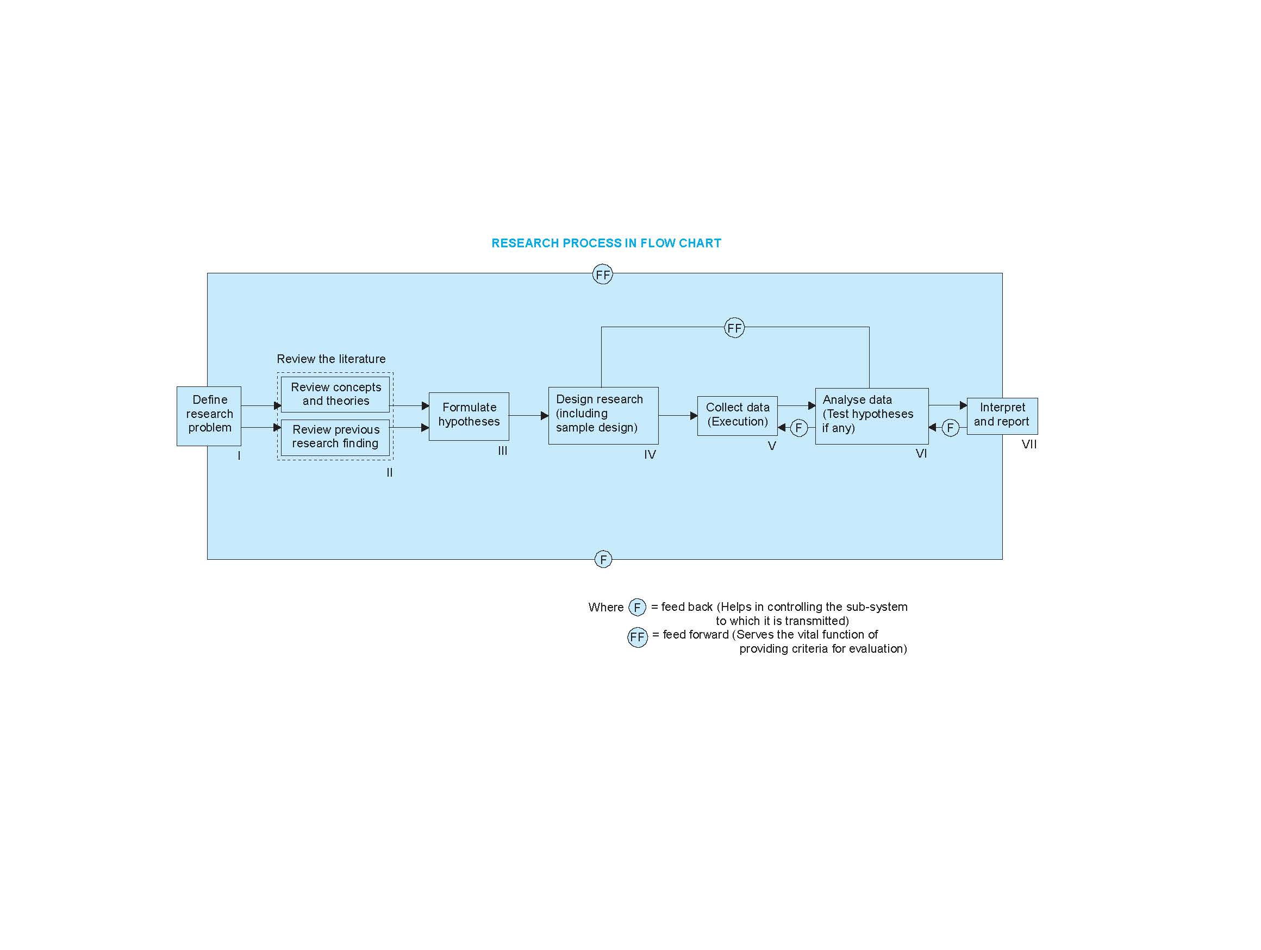

Slide 20
Step 1. State the Problem
At the very outset the researcher must single out the problem he wants to study, i.e., he must decide the general area of interest or aspect of a subject-matter that he would like to inquire into.
Initially the problem may be stated in a broad general way and then the ambiguities, if any, relating to the problem be resolved.
Then, the feasibility of a particular solution has to be considered before a working formulation of the problem can be set up.
The formulation of a general topic into a specific research problem, thus, constitutes the first step in a scientific enquiry.

Slide 21
Problem, cont..
Essentially two steps are involved in formulating the research problem, viz., understanding the problem thoroughly, and rephrasing the same into meaningful terms from an analytical point of view.
One simple technique for getting a problem in focus is to formulate a clear and explicit statement of the problem and put the statement in writing.
This may seem like an unnecessary instruction for a research scientist; however, it is frequently not followed.
The consequence is a vagueness and lack of focus that make it almost impossible to proceed.
It leads to the collection of unnecessary information or the failure to collect essential information.
Sometimes the original question is even lost as the researcher gets involved in the details of the experiment.

Slide 22
Step 2. Formulate the hypothesis.
After extensive literature survey, researcher should state in clear terms the working hypothesis or hypotheses.
Working hypothesis is tentative assumption made in order to draw out and test its logical or empirical consequences. As such the manner in which research hypotheses are developed is particularly important since they provide the focal point for research.
They also affect the manner in which tests must be conducted in the analysis of data and indirectly the quality of data which is required for the analysis.
In most types of research, the development of working hypothesis plays an important role.

Slide 23
Hypothesis, cont..
Hypothesis should be very specific and limited to the piece of research in hand because it has to be tested.
The role of the hypothesis is to guide the researcher by delimiting the area of research and to keep him on the right track. It sharpens his thinking and focuses attention on the more important facets of the problem.
It also indicates the type of data required and the type of methods of data analysis to be used.
Thus, working hypotheses arise as a result of a-priori thinking about the subject, examination of the available data and material including related studies and the counsel of experts and interested parties.

Slide 24
Step 3. Research Design
A design of research is developed for collection of data or evidences for testing the hypotheses. It involves method, sample and techniques of research. The appropriate method and techniques are selected for this purpose.
There are several research designs, such as, experimental and non-experimental hypothesis testing.
Experimental designs can be either informal designs (such as before-and-after without control, after-only with control, before-and-after with control) or
formal designs (such as completely randomized design, randomized block design, Latin square design, simple and complex factorial designs), out of which the researcher must select one for his own project.

Slide 25
Design, cont..
The preparation of the research design, appropriate for a particular research problem, involves usually the consideration of the following:
the means of obtaining the information;
the availability and skills of the researcher and his staff (if any);
explanation of the way in which selected means of obtaining information will be organized and the reasoning leading to the selection;
the time available for research; and
the cost factor relating to research, i.e., the finance available for the purpose.

Slide 26
Step 4. Data Collection
In dealing with any real life problem it is often found that data at hand are inadequate, and hence, it becomes necessary to collect data that are appropriate.
There are several ways of collecting the appropriate data which differ considerably in context of money costs, time and other resources at the disposal of the researcher.

Slide 27
Step 5. Interpret the data
After the data have been collected, the researcher turns to the task of analyzing them. The analysis of data requires a number of closely related operations such as establishment of categories, the application of these categories to raw data through coding, tabulation and then drawing statistical inferences.
To interpret the data, we set up the null hypothesis and then decide whether the experimental results are a rare outcome if the null hypothesis is true.
That is, we decide whether the difference between the experimental outcome and the null hypothesis is due to more than chance; if so, this indicates that the null hypothesis should be rejected.

Slide 28
Step 6. Draw conclusion and writing report
Include a statement that accepts or rejects the hypothesis. Make recommendations for further study and possible improvements to the procedure.
Finally, the researcher has to prepare the report of what has been done by him. Writing of report must be done with great care.
The writing of research report is usually the concluding task of the research endeavor. Every thing is combined together during the writing of the report.
This is the point at which the research must be essentially reproduced in written form.
It is a matter of communicating what was done, what occurred, and what the results mean in a concise, understandable, accurate and logical manner.

Slide 29
Characteristics of a good research
Whatever may be the types of research works and studies, one thing that is important is that they all meet on the common ground of scientific method employed by them.
One expects scientific research to satisfy the following criteria:
The purpose of the research should be clearly defined and common concepts be used.
The research procedure used should be described in sufficient detail to permit another researcher to repeat the research for further advancement, keeping the continuity of what has already been attained.
The procedural design of the research should be carefully planned to yield results that are as objective as possible.

Slide 30
Good research…
4. The researcher should report with complete frankness, flaws in procedural design and estimate their effects upon the findings.
5. The analysis of data should be sufficiently adequate to reveal its significance and the methods of analysis used should be appropriate. The validity and reliability of the data should be checked carefully.
6. Conclusions should be confined to those justified by the data of the research and limited to those for which the data provide an adequate basis.
7. Greater confidence in research is warranted if the researcher is experienced, has a good reputation in research and is a person of integrity.

Slide 31
Good Research…
In other words, we can state the qualities of a good research as :
Good research is systematic: It means that research is structured with specified steps to be taken in a specified sequence in accordance with the well defined set of rules. Systematic characteristic of the research does not rule out creative thinking but it certainly does reject the use of guessing and intuition in arriving at conclusions.
Good research is logical: This implies that research is guided by the rules of logical reasoning and the logical process of induction and deduction are of great value in carrying out research.
Induction is the process of reasoning from a part to the whole whereas
deduction is the process of reasoning from some premise to a conclusion which follows from that very premise.
In fact, logical reasoning makes research more meaningful in the context of decision making.

Slide 32
Good Research…
3. Good research is empirical: It implies that research is related basically to one or more aspects of a real situation and deals with concrete data that provides a basis for external validity to research results.
4. Good research is replicable: This characteristic allows research results to be verified by replicating the study and thereby building a sound basis for decisions.

Slide 33
Thank you!

